Slide 2
Agilne metode u obrazovanju

Slide 4
„Htio bih samo da iz srednje izađu normalni i željni da idu dalje s učenjem uz minimalnu količinu zatucanosti i uskogrudnosti :)”

Slide 5
„Ma spominjati konkretne tehnologije srednjoškolcima bi bio potpuni promašaj. Pa dok upišu fax se to već bude promijenilo, a kamoli kasnije.”

Slide 6
„Graditi ih kao ljude i upoznavati s tehnologijom kao alatom za rješavanje problema današnjice i bok :)”

Slide 8
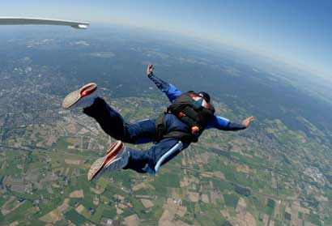

Notes:
Ovaj slajd je nastao iz dvije priče:
…promatrajući prijatelje penjače (po stijenama), primijetio sam da jedan od njih ima naljepnicu na autu na kojoj piše „Gravity Works”. Zanimljivo i vrlo jednostavno. Penjači znaju na što uvijek moraju planirati – gravitaciju. Znaju za nju, poštuju je i planiraju na nju. Nastavak na sljedećem slajdu…
…U trenutku skoka iz aviona mogu razmišljati o tome što mi je ovo trebalo, mogu kriviti bilo koga (ljutiti se) što sam ovdje u zraku, ali zapravo za to nemam vremena. Moram se brzo prilagoditi jer mi se stavrnost vrlo brzo približava ;-)

Slide 9
Potrebe korisnika se mijenjaju. Gravity.
Mogućnosti tima su poznate samo timu i mijenjaju se
tijekom vremena. Gravity.
Svijet se mijenja velikom brzinom pri čemu se stvaraju situacije
koje nitko ne može predvidjeti. Gravity.
Ne možemo se obvezati u tuđe ime i očekivati od drugih
da se ponašaju u skladu s time. Gravity.
Notes:
Kao što penjači računaju na gravitaciju, tako i mi moramo na nešto računati i planirati. Vidi što piše na slajdu na što se misli.

Slide 10
Agile Manifesto (2001.)
We are uncovering better ways of developing
software by doing it and helping others do it.
Through this work we have come to value:
Individuals and interactions over processes and tools
Working software over comprehensive documentation
Customer collaboration over contract negotiation
Responding to change over following a plan
That is, while there is value in the items on
the right, we value the items on the left more.

Slide 11
Individuals and interactions over processes and tools
Working software over comprehensive documentation
Customer collaboration over contract negotiation
Responding to change over following a plan
That is, while there is value in the items on
the right, we value the items on the left more.

Slide 13
12 agilnih principa
Our highest priority is to satisfy the customer through early and continuous delivery of valuable software.
Welcome changing requirements, even late in development. Agile processes harness change for the customer's competitive advantage.
Deliver working software frequently, from a couple of weeks to a couple of months, with a preference to the shorter timescale.
Business people and developers must work together daily throughout the project.
Build projects around motivated individuals. Give them the environment and support they need, and trust them to get the job done.
The most efficient and effective method of conveying information to and within a development team is face-to-face conversation.
Notes:
Ne zadržavati se previše na ovome.

Slide 14
12 agilnih principa
Working software is the primary measure of progress.
Agile processes promote sustainable development.
The sponsors, developers, and users should be able to maintain a constant pace indefinitely.
Continuous attention to technical excellence and good design enhances agility.
Simplicity--the art of maximizing the amount of work not done--is essential.
The best architectures, requirements, and designs emerge from self-organizing teams.
At regular intervals, the team reflects on how to become more effective, then tunes and adjusts its behavior accordingly.
Notes:
Ne zadržavati se previše na ovome.

Slide 15
Tradicionalni mediji
Kralj – gospodin E-mail
Kraljica – Word, Excel
Ticketing sustav i reporti
Telefon i messanger
Checkpoint sastanci
Face-to-face ‘demoliranje’

Slide 16
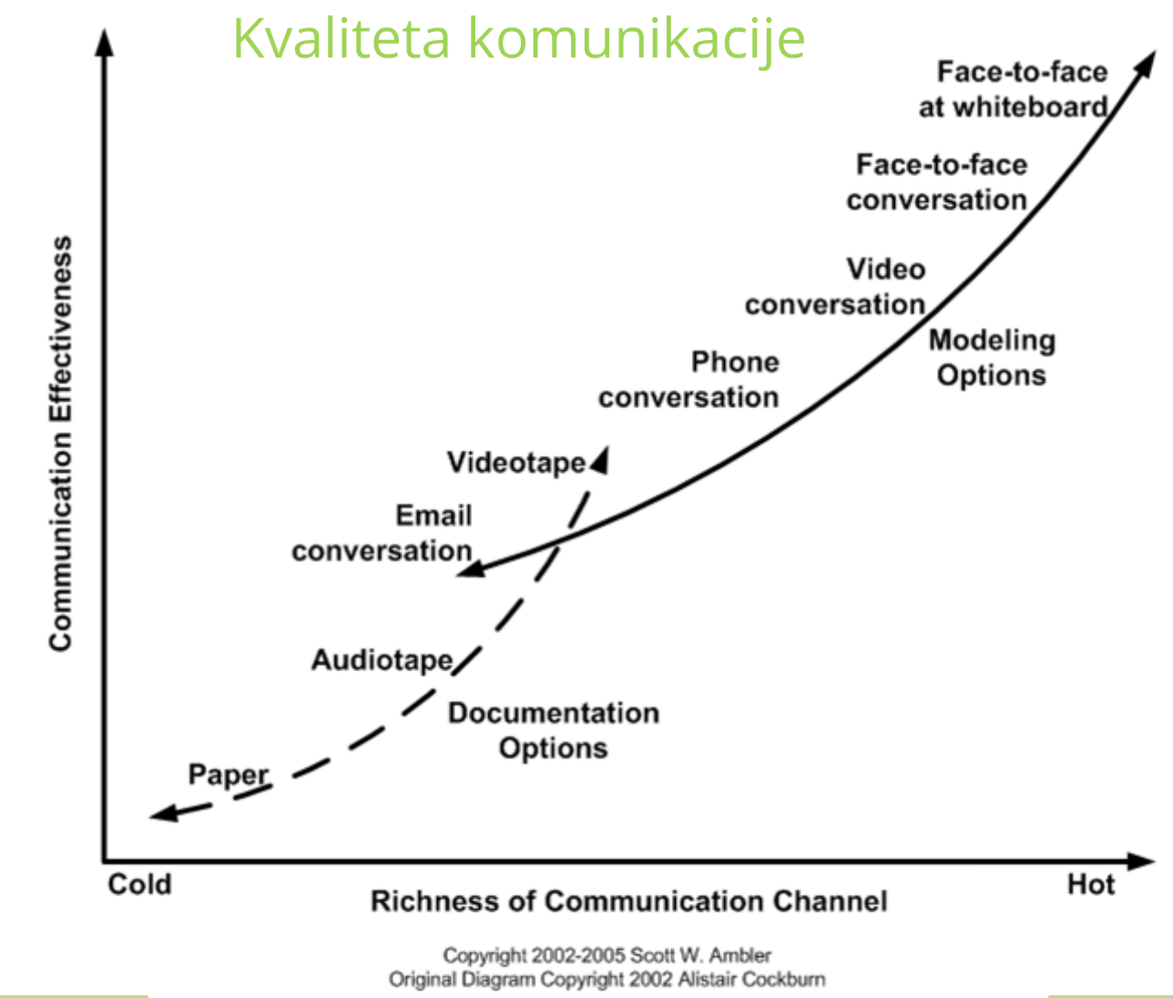

Slide 17
Kanban
Prakse:
Vizualizacija
Limitirati posao u tijeku (WIP)
Upravljanje tokom (JIT)
Eksplicitno objaviti pravila
Implementirati feedback točke
Poboljšati cjelinu eksperimentirajući

Slide 19
Tranzicija je promjena kulture, trajat će,
neće se svima svidjeti ali mora se dogoditi.

Slide 20
Kako mi međusobno prenosimo znanje?

Slide 21
Sustavi uglavnom nagrađuju ljude za imanje znanja a ne za dijeljenje znanja.
…malo se prijenosa znanja događa sustavno
...događa se po inicijativi pojedinih ljudi, ali nemamo sustavnog prijenosa znanja što je katastrofalno.

Slide 22


Slide 23
SCRUM

Slide 24
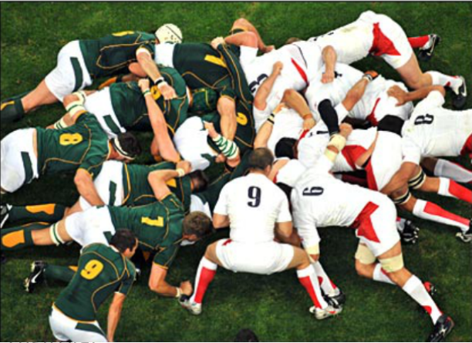

Slide 25
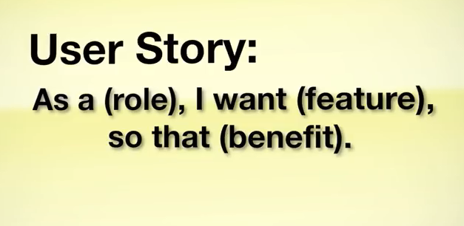

Slide 26
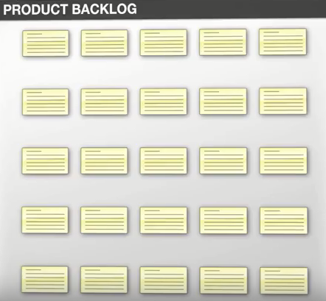

Slide 27


Scrum uloge
Scrum master
Product owner
Team Work
Team
Notes:
Team: dedicated collection of self-organizing, interdependent, co-located individuals representing different functional roles with all the necessary skills to turn Product Backlog items into a potentially shippable increment within the Sprint.
Product Owner: an empowered individual applying their personal and professional judgment to make decisions in the best interest of different,often times competing, business stakeholders to maximize the business value the Team produces each Sprint
ScrumMaster: a dedicated individual responsible for improving the performance of the Team and the business by any means necessary.
Stakeholder: any person who has a direct, or indirect, interest in the work of the Team.
Keep in mind, these are role definition, not job descriptions and they are very loosely defined. It is important that each role is filled. In general, the Product Owner is concentrated on the providing valuable business outcomes to the business, while ScrumMaster is aiming his\her efforts at the execution of good Scrum and improving the flow of value to the customer. Meanwhile, the Team remains centered on learning how to self-organize and deliver potentially shippable increments regularly. Stakeholders provide feedback on the value of everyone’s efforts.
- See more at: http://lookforwardconsulting.com/2011/01/21/scrum-roles-defined/#sthash.TLTMjNY9.dpuf

Slide 28
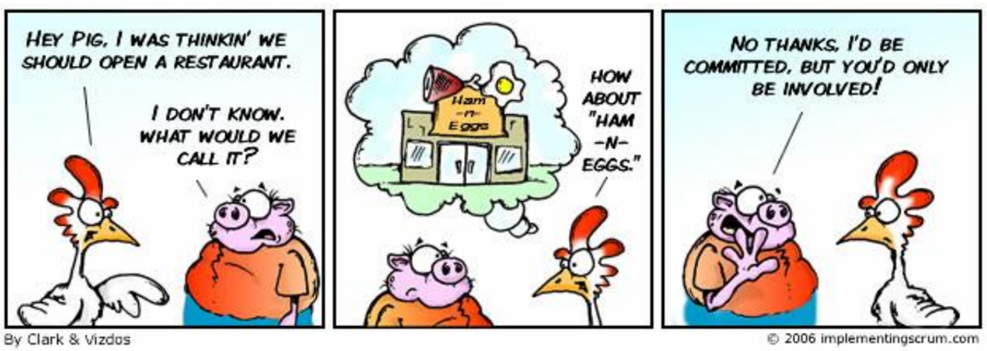

Slide 30
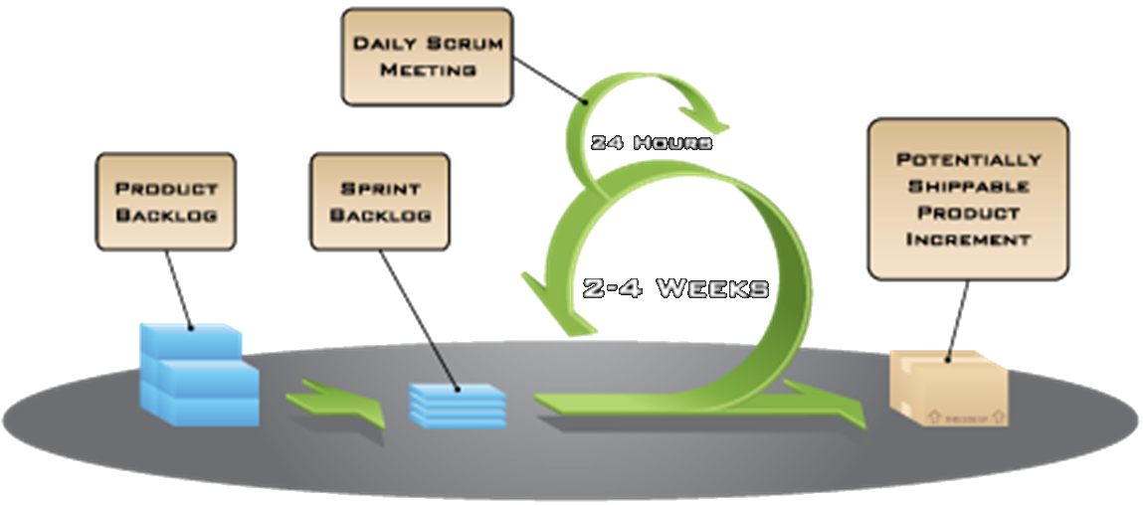

Slide 31
Planning meeting 1
Kada: Prvi dan sprinta
Tko: Tim, Product Owner, Scrum Master
ŠTO će se graditi u sljedećem sprintu?
Product Owner donosi zahtjeve i rizike, te sve detalje
Dogovara se CILJ sprinta
Sastanak završava u trenutku kada tim ima dovoljno informacija
(cca 2h na 2 tjedna sprinta)

Slide 32
Planning meeting 2
Kada: Prvi dan sprinta
Tko: Odvija se bez Product Ownera
Tim dogovara KAKO će ispuniti ciljeve
Izgrađuje se Sprint Backlog, posao razbijen na taskove u trajanju do 8h
Traje cca 2h na 2 tjedna sprinta

Slide 33
Daily Standup Meeting
Kada: Uvijek u isto vrijeme, na istom mjestu , max 15 minuta
Tko: Tim, Product Owner, Scrum Master
Nije za rješavanje problema, ali je za njihovo otkrivanje
Što sam napravio od prošlog sastanka?
Što ću raditi do sljedećeg sastanka?
Na koje probleme sam naišao?

Slide 34
Review meeting
Kada: Zadnji dan sprinta
Tko: Sudjeluje tim i Scrum Master
Što smo napravili dobro, što loše?
Jesmo li riješili prepreke? Koliko smo promašili procjene?
Možemo li napredovati? Treba li nam specijalist? Kako se osjećamo?
Bitna je iskrenost, temelj je za kontinuirano poboljšanje
Traje oko 1h na dva tjedna sprinta

Slide 35
Retrospective
Kada: Zadnji dan sprinta
Tko: Sudjeluju svi
Demonstrira se ono što je GOTOVO
Može utjecati na planiranje sljedećeg sprinta
Gradi povjerenje, transparentnost i traje oko 1h na dva tjedna sprinta

Slide 36
http://www.agileineducation.org/examples.html
https://www.agile42.com/en/blog/2016/07/12/agile-education/
https://www.agilealliance.org/resources/sessions/agile-education/

