Slide 1
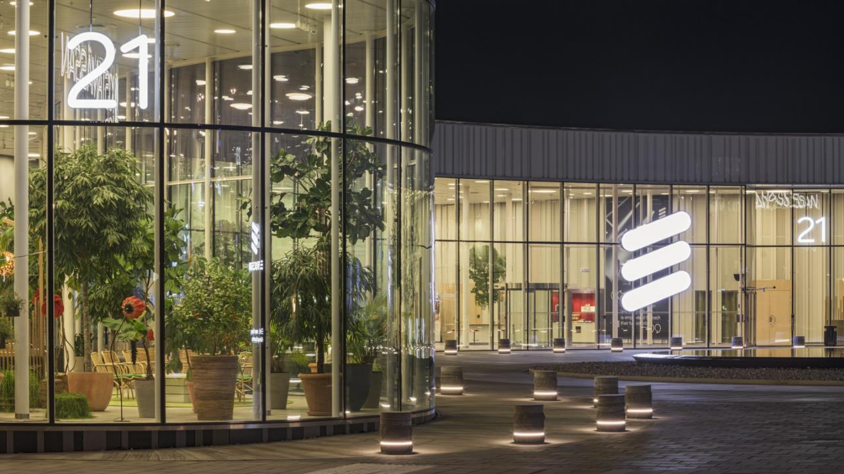
THIS IS ERICSSON NT
Damir Medved
Principal Consultant & Manager New Area Sales
Notes:
Latest update: January, 2018 (updates done after Mobility Report releases and after Annual Report release)
IMAGE: Ericsson HQ entrance in Kista, Stockholm - Sweden.
This presentation is intended for an external audience with minor telecom knowledge, with the purpose to give a clear and impressive picture of Ericsson and our role in the world. The presentation is updated according to our latest annual report and with the Mobility report releases.
SLIDE STORY: Speaker to introduce him/herself and set the scene for the presentation
It is great to be here and meet with all of you
(add question to audience if desirable) – When you woke up this morning and saw in you agenda that you were going to listen to a presentation about Ericsson. What were you expecting to hear?
I believe all of us here today can agree that there has been a great disruption in how we consume media, how we keep in contact with authorities, how we interact with other services like banking and transportation.
On the other hand of this, disruptive forces is part of running a business today – either if you are representing an industry that has been around for 140 years, like us at Ericsson, or if you recently introduced a new services model to the market.
A transformation is happening… and it has started in a fairly short time period and with a huge impact on companies and societies around the world.
Transformation and our role in it will be a key theme in this presentation.

Slide 2
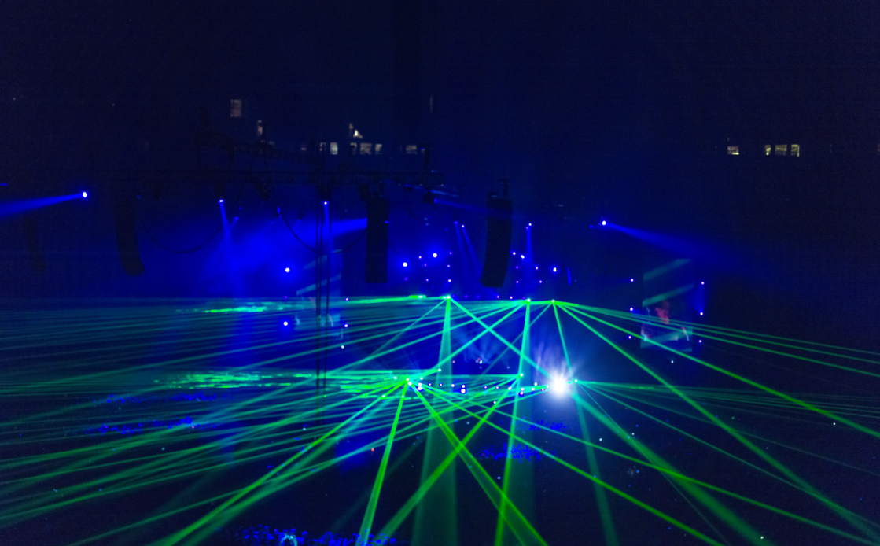
ERICSSON Nikola tesla Group –
This is us!
70%
14 years
2900+
Highly educated experts
Average employment duration
6%
Employees in Zagreb and Split
Doctors of Science and Masters of Science
29%
41 years
Employees younger than 32
Average employee age
28%
77% : 23%
22%
Employees with up to 2 years of work experience
Gender ratio (male vs. female)
Female managers

Slide 3

At an inflection point
5G
IoT
Cloud
INSTALLATION
TRANSFORMATION
+
+
The 5th technological revolution
Notes:
SLIDE STORY: Details about the driving forces of the technological revolution underway, the benefits it brings and Ericsson’s role.
While the past decades of ICT progress have been promising, they have only laid the foundation for what is to come.
Through history large changes have been brought about by something we call ‘general purpose’ technologies: Iron, Steam, coal, and railways were general-purpose technologies in the Industrial Age. The importance of these technologies increase as they stretched into other industries and started to bring about society wide transformation.
In the ICT world today, these general-purpose technologies are 5G, Internet of Things (IoT) and Cloud. But ICT is different from other originating industries for general purpose technologies in the sense of the rapid capability development it is undergoing.
We today see signs of exponential innovation as a result of 5G, IoT and Cloud reaching the transformational stage. These technologies, as enabling platforms, share common characteristics critical to the success of any industry in the Networked Society: They facilitate new growth, enable business agility, foster innovation, create efficiencies and they are fertile grounds for ecosystems to thrive and prosper
5G is heralding a new era of mobility. It will be an innovation platform for both consumers and businesses, helping to turn ideas into a reality, from autonomous vehicles to critical control of remote devices like heavy machinery and even remote surgery to immersive augmented reality.
With things around us increasingly connected, IoT has quickly emerged as a major agent of transformation for all industries as it blends the physical and digital worlds, linking industries and creating true value in the Networked Society.
Cloud is bringing unprecedented agility, efficiency and accessibility to every industry, reshaping ecosystems and enabling new business models.
Through our technology and services leadership as well as our industry commitments and innovations, we are spear hearing accelerating developments through 5G, IoT and Cloud to the benefit of all.
In our view, the exponential innovation that we will see and which will change the world as we know it can largely be explained through the following factors:
Exponential performance; doubling processing power…
Universal reach: global uptake of mobile technology on individual level
New scale in economics: digital distribution

Slide 4
PACE OF CHANGE and greater connectivity
50
Our vision
50 billion connected devices
40
15 years
26 billion connected devices
30
Connected (billions)
25 years
5 billion connected people
20
10
100 years
1 billion connected places
1900
2000
2010
2020

Slide 5
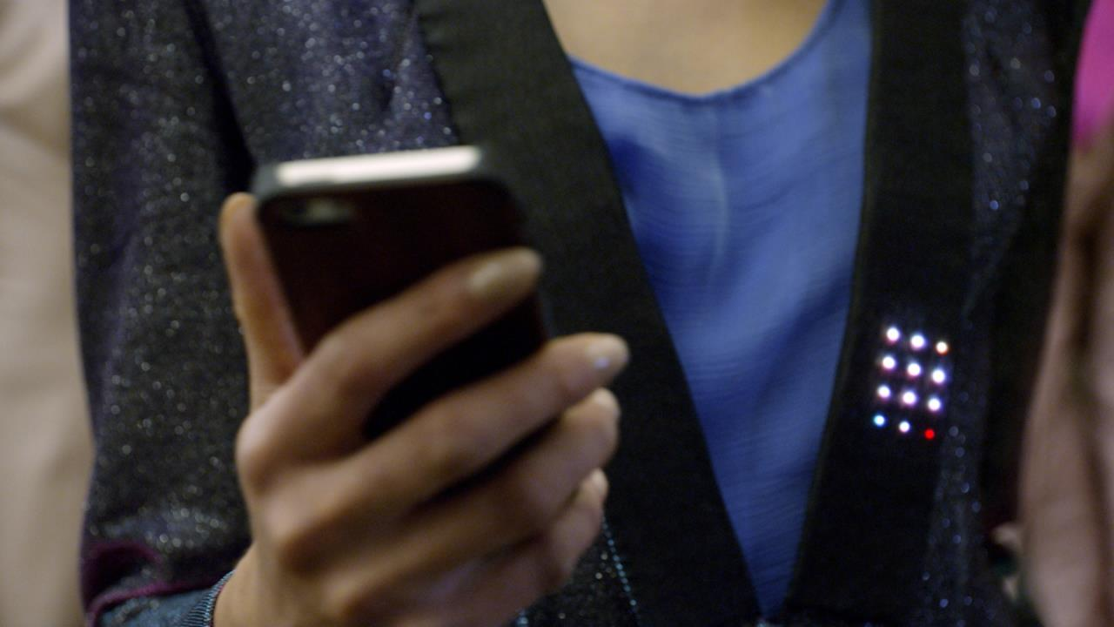
New behaviors
$93 MILLION
CROWDFUNDING RAISED PER DAY
20 MINUTES
SPENT ON FACEBOOK
PER DAY
$ 6.3 BILLION
E-COMMERCE PER DAY
1.6 MILLION
NEW SMARTPHONE SUBSCRIPTIONS PER DAY
3X
UBER REVENUE OVER SIZE OF TAXI MARKET, IN SAN FRANCISCO
24h
500,000
AIRBNB STAYS PER NIGHT
5 BILLION
VIDEOS WATCHED ON YOUTUBE PER DAY
Notes:
SLIDE STORY: Showing new behaviors among users, using some large numbers for a day which most people can understand and relate to, aimed at creating some level of “wow”
We have 1.6 million new Smartphone subscriptions added per day, everyone is becoming connected
And going through a usual day, we see that people are doing things that would have been very out of the ordinary just some ten years ago
You may wake up with your smartphone under the pillow and start the day by liking something on Facebook
Then you may spend some money on crowdfunding or e-commerce, both growing immensely
Kick back watching Youtube, or some other film streaming service
Leave work with an Uber taxi, a company which today has three times the revenue of the San Francisco taxi market (likely reason is adding peer-to-peer services and other services not included in a taxi market size estimation, e.g. food delivery)
To go to rest in someone else’s house which you rent via AIRBNB
(add question to audience if desirable) –” Would you voluntarily switch off mobile data from your mobile phone for one week?”
NOTE: all figures are per day, except Uber figure which is a market size to revenue comparison.
Sources below. Some figures are lagging since new data is not accessible, hence, use for illustrational purposes only. For data sources and more info see below.
Smartphone subscriptions
1.6 million new Smartphone subscriptions added per day (Mobility Report June 2017, 2016 figure subtracted by 2015 figure and divided by 365 days)
Facebook (latest update 2016)
Users spend an average of 20 minutes per day on the site.
https://www.brandwatch.com/blog/47-facebook-statistics-2016/
Crowdfunding (latest updated 2015)
Total global crowdfunding industry estimated fundraising volume in 2015: 34 billion usd. Divided by 365 days gives 93MUSD.
http://crowdexpert.com/crowdfunding-industry-statistics/
E-commerce (est. 2017)
XX billion usd in global value. Based on estimated 2.3 trillion USD value for 2017 divided by 365.
https://www.ipc.be/en/knowledge-centre/e-commerce/articles/global-ecommerce-figures-2017
Uber stats (last updated 2015)
According to Uber CEO Travis Kalanick, who spoke at the DLD Conference in Munich on Sunday, the taxi market in San Francisco is about $140 million per year.Uber's revenues in San Francisco, meanwhile, are running at $500 million per year. Read more: http://uk.businessinsider.com/uber-revenue-san-francisco-2015-1?r=US&IR=T#ixzz3kO071s9p
YouTube (latest update 2017)
Almost 5 billion videos are watched on YouTube every single day (YouTube Statistics - 2017)
https://fortunelords.com/youtube-statistics/
Airbnb stats (last updated 5/27/15)
http://expandedramblings.com/index.php/airbnb-statistics/

Slide 6

Industry Transformation
HEALTH
EDUCATION
MEDIA
BANKING
UTILITY
RETAIL
TRANSPORT
WELLNESS
LEARNING
CULTURE
TRANSACT
FUNCTION
EXCHANGE
MOBILITY
Notes:
SLIDE STORY: Just as with consumers and changes in behaviors we also see a shift in industries, business models and business logics
Just as we see our behaviors change there is also a change in the companies and industries providing the goods and services
There is a New Logic being applied across industries. Music was one of the first to completely change – from a physical goods delivery industry to a digitally connected one. Other industries are now set to follow.
The New Logic will allow new capabilities that are part of the ICT revolution to gradually evolve or disruptively change industries. Examples of these capabilities are:
The shift from physical products to service delivery (think of Netflix or Spotify);
The major influence from consumers before, during and after purchase (think of crowdsourcing, instant customer feedback etc.);
Connected things with the possibility for everything in and around a value chain to be communicating (think of connected transport packages).
In fact, the very concept of these industries can be transformed. Think of Transportation becoming Mobility, Retail to Exchange and Education to Learning, Healthcare moves from being perceived as a reactive treatment of illness to a proactive securement of wellness.

Slide 7

Trends and Outlook
INCREASINGLY DIVERSE PLETHORA OF APPLICATIONS
Massive amounts of large-scale and niche applications, transforming industries and entire societies
SERVICE AGILITY
Quick creation, deployment and easy operation of new services
ULTRA-HIGH PERFORMANCE AT LOW COST
Tough and diverse
performance requirements
5G - A platform that enables quick development and easy operation
of networked society applications, with the required performance

Slide 8

5G – The Networked Society Platform
CONVERGED INFRASTRUCTURE
AUTOMATED & PROGRAMMABLE
Hiding heterogeneity and complexity
Combined radio, transport and compute
Bootstrapping a slice within minutes
Programmability at all layers
5G
INTEGRATED MACHINE INTELLIGENCE
PERFORMANCE FEATURES THROUGHOUT THE SYSTEM
Powering network and external applications, within low-latency control loops
Supporting highly diverse and demanding application requirements

Slide 9

BROADBAND AND MEDIA EVERYWHERE
SMART VEHICLES,
TRANSPORT
5g
CRITICAL SERVICES AND INFRASTRUCTURE CONTROL
CRITICAL CONTROL
OF REMOTE DEVICES
USE CASES
HUMAN MACHINE INTERACTION
SENSOR NETWORKS

Slide 10
5G APPLICATION Examples
COLLABORATIVE CLOUD ROBOTICS
Interacting industrial robots, complex combinations of control loops
executed in cloud
MASSIVE MEDIA DISTRIBUTION
Massive amounts of media content distributed to homes and
people on the move

Slide 11


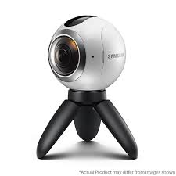


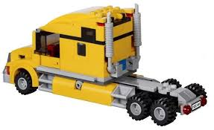
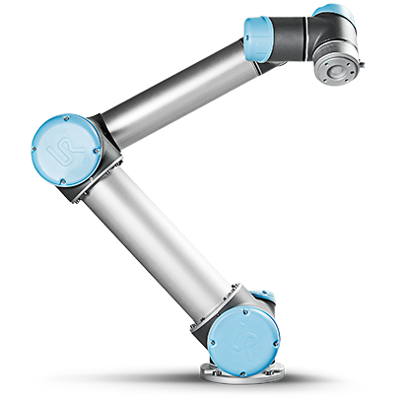


A possible Robotics story
3. Boxes are pushed
by Spheros depending
on weight
To highlight why cloud and 5G capabilities are needed, dynamic, cooperative, and real-time
Multiple robots collaborate to perform a common task defined in the cloud
Task is dynamic and complex, needs to react to environment
1. Camera
detects objects
4. Arm picks
up boxes and puts them
on top of the pile
5. LEGO truck
carries piles away
GOTO 1.
2. Sphero pool
in stand-by

Slide 12



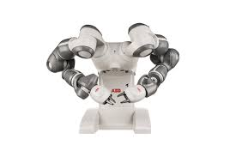



Complex story v2
3. Boxes are pushed
by Spheros depending
on weight
7. Spheros push
box back to Robot-2
GOTO 1
6. Robot-2:
Remove objects
from moving truck
using haptic
remote control
1. Camera
detects objects
4. Arm picks
up boxes and puts them
on top of the pile
5. LEGO truck
carries piles to
Robot-2
2. Sphero pool
in stand-by

Slide 13
VIDEOS
https://www.ericsson.com/en/cases/2016/5gtuscany/transforming-industry-with-5g-cloud-robotics
https://www.ericsson.com/en/cases/2017/smartfactory
https://www.ericsson.com/en/5g

Slide 14
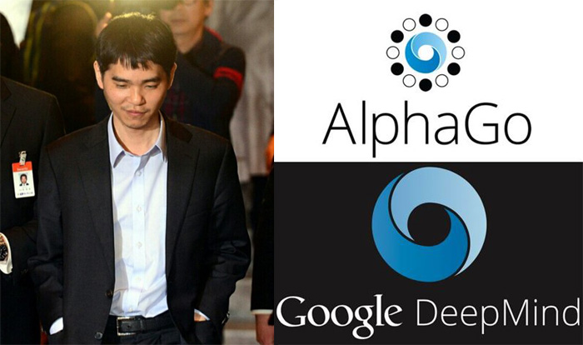
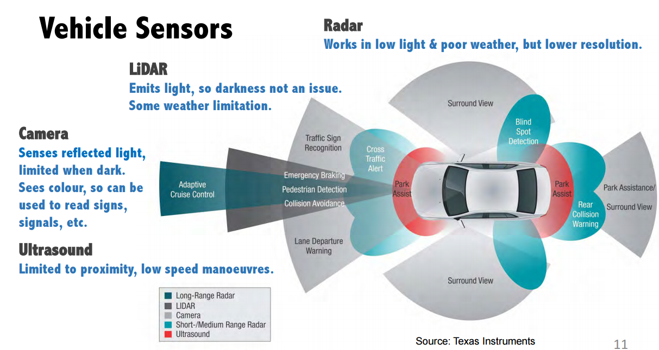
DEFINITIONS
Artificial Narrow Intelligence (ANI):
Sometimes referred to as Weak AI, Artificial Narrow Intelligence is AI that specializes in one area. There’s AI that can beat the world chess champion in chess, but that’s the only thing it does. Ask it to figure out a better way to store data on a hard drive, and it’ll look at you blankly.
Notes:
Cars are full of ANI systems, from the computer that figures out when the anti-lock brakes should kick in to the computer that tunes the parameters of the fuel injection systems. Google’s self-driving car, which is being tested now, will contain robust ANI systems that allow it to perceive and react to the world around it.
Your phone is a little ANI factory. When you navigate using your map app, receive tailored music recommendations from Pandora, check tomorrow’s weather, talk to Siri, or dozens of other everyday activities, you’re using ANI.
Your email spam filter is a classic type of ANI—it starts off loaded with intelligence about how to figure out what’s spam and what’s not, and then it learns and tailors its intelligence to you as it gets experience with your particular preferences. The Nest Thermostat does the same thing as it starts to figure out your typical routine and act accordingly.
You know the whole creepy thing that goes on when you search for a product on Amazon and then you see that as a “recommended for you” product on a different site, or when Facebook somehow knows who it makes sense for you to add as a friend? That’s a network of ANI systems, working together to inform each other about who you are and what you like and then using that information to decide what to show you. Same goes for Amazon’s “People who bought this also bought…” thing—that’s an ANI system whose job it is to gather info from the behavior of millions of customers and synthesize that info to cleverly upsell you so you’ll buy more things.
Google Translate is another classic ANI system—impressively good at one narrow task. Voice recognition is another, and there are a bunch of apps that use those two ANIs as a tag team, allowing you to speak a sentence in one language and have the phone spit out the same sentence in another.
When your plane lands, it’s not a human that decides which gate it should go to. Just like it’s not a human that determined the price of your ticket.
The world’s best Checkers, Chess, Scrabble, Backgammon, and Othello players are now all ANI systems.
Google search is one large ANI brain with incredibly sophisticated methods for ranking pages and figuring out what to show you in particular. Same goes for Facebook’s Newsfeed.
And those are just in the consumer world. Sophisticated ANI systems are widely used in sectors and industries like military, manufacturing, and finance (algorithmic high-frequency AI traders account for more than half of equity shares traded on US markets6), and in expert systems like those that help doctors make diagnoses and, most famously, IBM’s Watson, who contained enough facts and understood coy Trebek-speak well enough to soundly beat the most prolific Jeopardy champions.
ANI systems as they are now aren’t especially scary. At worst, a glitchy or badly-programmed ANI can cause an isolated catastrophe like knocking out a power grid, causing a harmful nuclear power plant malfunction, or triggering a financial markets disaster (like the 2010 Flash Crash when an ANI program reacted the wrong way to an unexpected situation and caused the stock market to briefly plummet, taking $1 trillion of market value with it, only part of which was recovered when the mistake was corrected).
But while ANI doesn’t have the capability to cause an existential threat, we should see this increasingly large and complex ecosystem of relatively-harmless ANI as a precursor of the world-altering hurricane that’s on the way. Each new ANI innovation quietly adds another brick onto the road to AGI and ASI. Or as Aaron Saenz sees it, our world’s ANI systems “are like the amino acids in the early Earth’s primordial ooze”—the inanimate stuff of life that, one unexpected day, woke up.

Slide 15
DEFINITIONS
Artificial General Intelligence (AGI):
Sometimes referred to as Strong AI, or Human-Level AI, Artificial General Intelligence refers to a computer that is as smart as a human across the board—a machine that can perform any intellectual task that a human being can. Creating AGI is a much harder task than creating ANI, and we’re yet to do it.
Professor Linda Gottfredson describes intelligence as “a very general mental capability that, among other things, involves the ability to reason, plan, solve problems, think abstractly, comprehend complex ideas, learn quickly, and learn from experience.” AGI would be able to do all of those things as easily as you can.

Slide 16
DEFINITIONS
Artificial Superintelligence (ASI):
Oxford philosopher and leading AI thinker Nick Bostrom defines superintelligence as “an intellect that is much smarter than the best human brains in practically every field, including scientific creativity, general wisdom and social skills.”
Artificial Superintelligence ranges from a computer that’s just a little smarter than a human to one that’s trillions of times smarter—across the board. ASI is the reason the topic of AI is such a spicy meatball and why the words “immortality” and “extinction” will both appear in these posts multiple times.

Slide 17
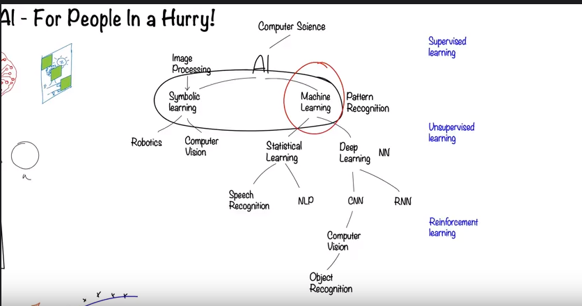
AI BUILDING BLOCKS
NLP – Natural Language Processing, NN – Neural Networks
RNN – Recurent Neural Network, CNN – Convolution Neural Network
https://youtu.be/2ePf9rue1Ao
Notes:
CNN - reckognizing objects in the sceene
RNN – remembering limited past
Supervized learning – give friend name
Unsupervized – work alone
Reinforcement - Try and go

Slide 18
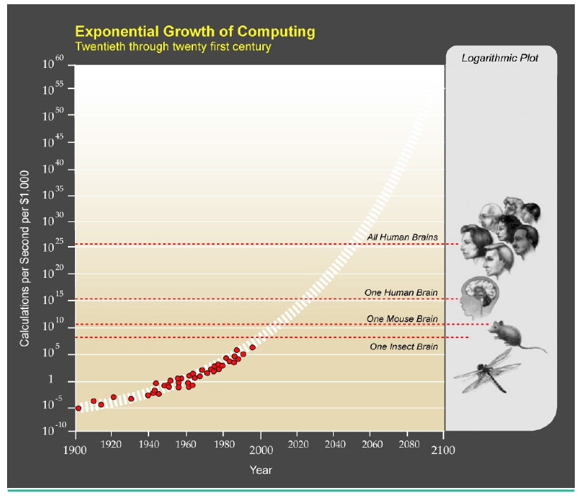
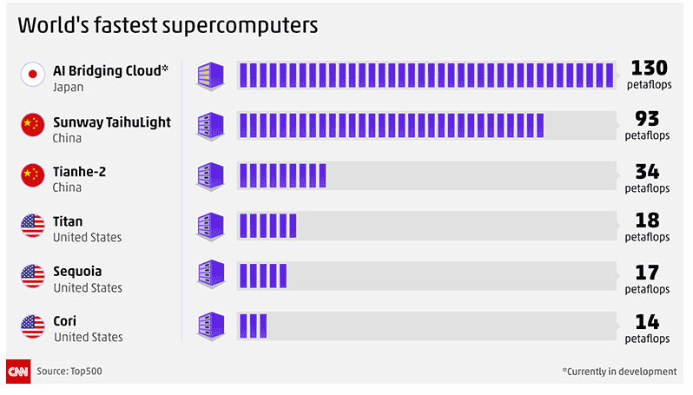
PREDICTIONS vs. REALITY
Geest predicted that by 2018, a quantum computer will be built that has the same computational power as every computer on earth today (2017) combined.
Notes:
Source:
Yuri van Geest, founder of SingularityU in the Netherlands and an expert in the singularity, said at Cologne’s Pirate Summit in 2016 that analytical jobs would prove child’s play for a quantum computer, crunching through the tasks in a blink of an eye.ce: Ray Kurtzweil – The Sinuglarity is Near , 2005.
A petaflop is the ability of a computer to do one quadrillion (10on15) floating point operations per second (FLOPS). Additionally, a petaflop can be measured as one thousand teraflops.
NameUnitValue
kiloFLOPSkFLOPS10³
megaFLOPSMFLOPS10⁶
gigaFLOPSGFLOPS10⁹
teraFLOPSTFLOPS10¹²
petaFLOPSPFLOPS10¹⁵
exaFLOPSEFLOPS10¹⁸
zettaFLOPSZFLOPS10²¹
yottaFLOPSYFLOPS10²⁴

Slide 19
FRIENDLY AI CONCEPTS
Basically we should assume that a 'superintelligence' would be able to achieve whatever goals it has. Therefore, it is extremely important that the goals we endow it with, and its entire motivation system, is 'human friendly.‘
  It takes decades for the first AI system to reach low-level general intelligence, but it finally happens. A computer is able to understand the world around it as well as a human four-year-old. Suddenly, within an hour of hitting that milestone, the system pumps out the grand theory of physics that unifies general relativity and quantum mechanics, something no human has been able to definitively do. 90 minutes after that, the AI has become an ASI, 170,000 times more intelligent than a human.
As far as we’re concerned, if an ASI comes to being, there is now an omnipotent God on Earth—and the all-important question for us is:
Will it be a nice God?

Slide 20
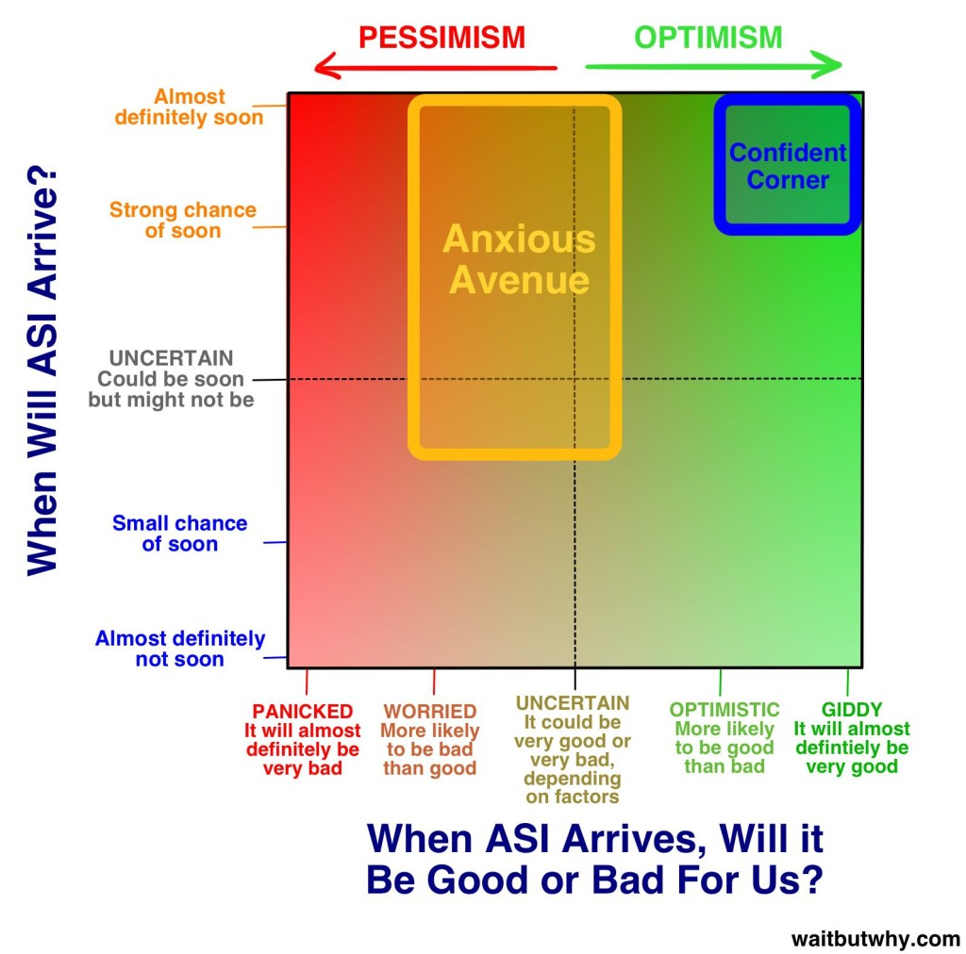
NICE GOD ?
Before the prospect of an intelligence explosion, we humans are like small children playing with a bomb. Such is the mismatch between the power of our plaything and the immaturity of our conduct. Superintelligence is a challenge for which we are not ready now and will not be ready for a long time. We have little idea when the detonation will occur, though if we hold the device to our ear we can hear a faint ticking sound.
Notes:
Source : https://waitbutwhy.com/2015/01/artificial-intelligence-revolution-2.html

Slide 21
Industrija 4.0 ili 4. Industrijska revolucija
… ili kontrarevolucija kako kažu neki.

Slide 22
Što je 4 industrijska revolucija
U ovoj prezentaciji izraz „Industrija 4.0" označava četvrtu industrijsku revoluciju. Ostali srodni pojmovi uključuju "Industrijski internet" ili "Digitalna tvornica", iako niti jedan od tih izraza ne daje kompletnu sliku.
Dok se Industrija 3.0 usredotočila na automatizaciju pojedinačnih strojeva i procesa, Industrija 4.0 usredotočuje se na digitalizaciju cjelokupne fizičke imovine i integraciju u digitalne ekosustave s partnerskim lancima vrijednosti.
Stvaranje, analiziranje i komuniciranje podataka neprimjetno podupire dobitke koje je obećala Industrija 4.0, a ona povezuje širok raspon novih tehnologija za stvaranje vrijednosti.

Slide 23
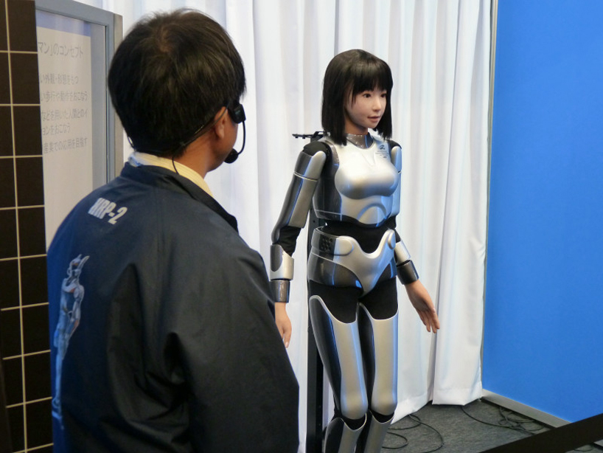
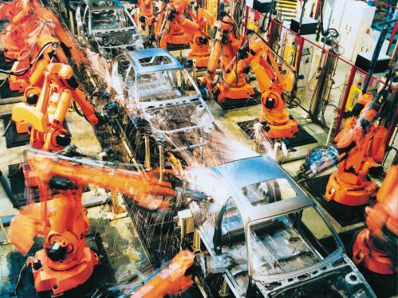
Disruptivna promjena – rast humanoidnih robota

Slide 24
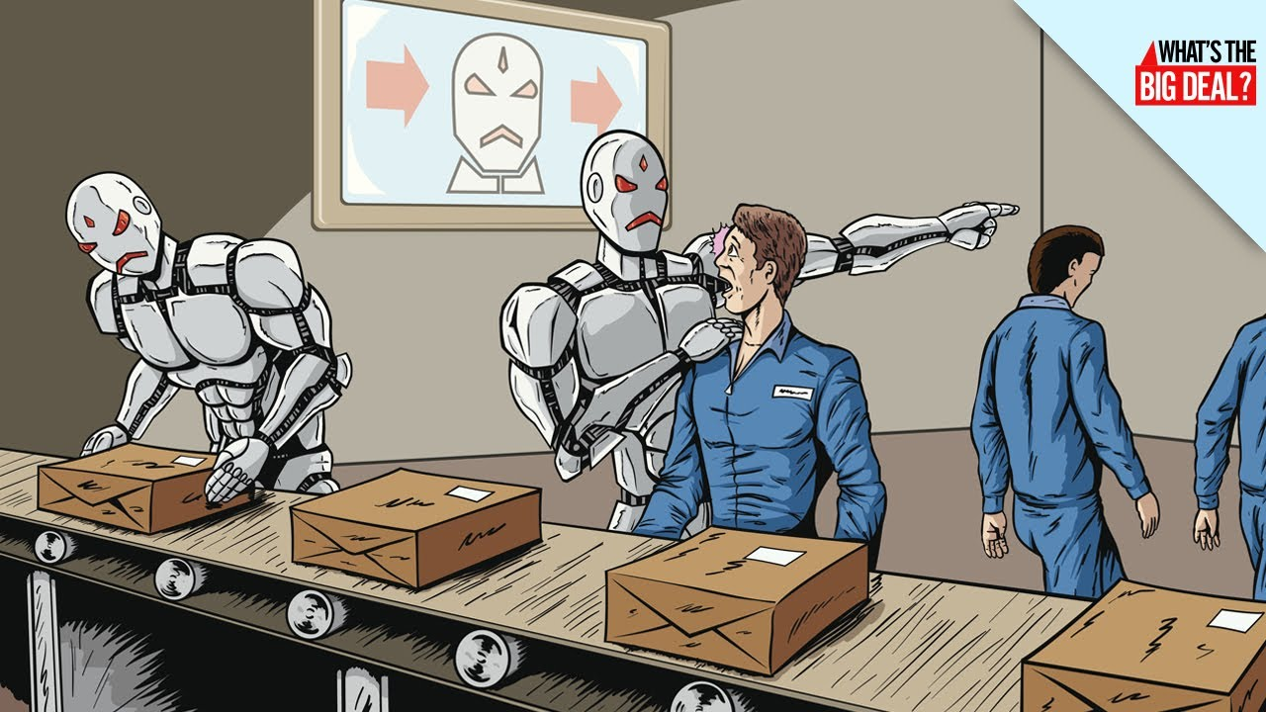

Slide 25
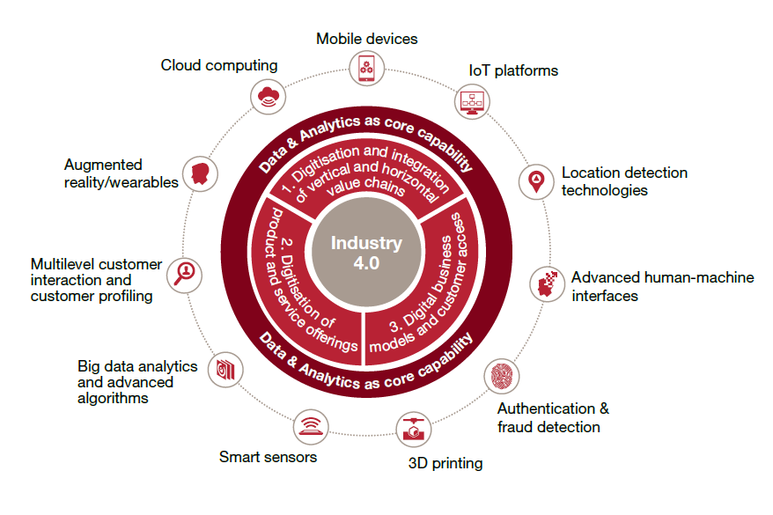
Industry 4.0 framework and contributing digital technologies
Notes:
Izvor: PwC’s 2016 Global Industry 4.0 Survey of industrial companies
1) Digitisation and integration of vertical and horizontal value chains
Industry 4.0 digitises and integrates processes vertically across the
entire organisation, from product development and purchasing, through
manufacturing, logistics and service.
All data about operations processes, process efficiency and quality
management, as well as operations planning are available real-time,
supported by augmented reality and optimised in an integrated network.
Horizontal integration stretches beyond the internal operations from suppliers
to customers and all key value chain partners. It includes technologies from
track and trace devices to real-time integrated planning with execution.
2) Digitisation of product and service offerings
Digitisation of products includes the expansion of existing products, e.g. by
adding smart sensors or communication devices that can be used with data
analytics tools, as well as the creation of new digitised products which focus
on completely integrated solutions.
By integrating new methods of dana collection and analysis, companies
are able to generate data on product use and refine products to meet the
increasing needs of end-customers.
3) Digital business models and customer access
Leading industrial companies also expand their offering by providing
disruptive digital solutions such as complete, data-driven services
and integrated platform solutions.
Disruptive digital business models are often focused on generating additional
digital revenues and optimising customer interaction and access. Digital
products and services frequently look to serve customers with complete solutions
in a distinct digital ecosystem.

Slide 26
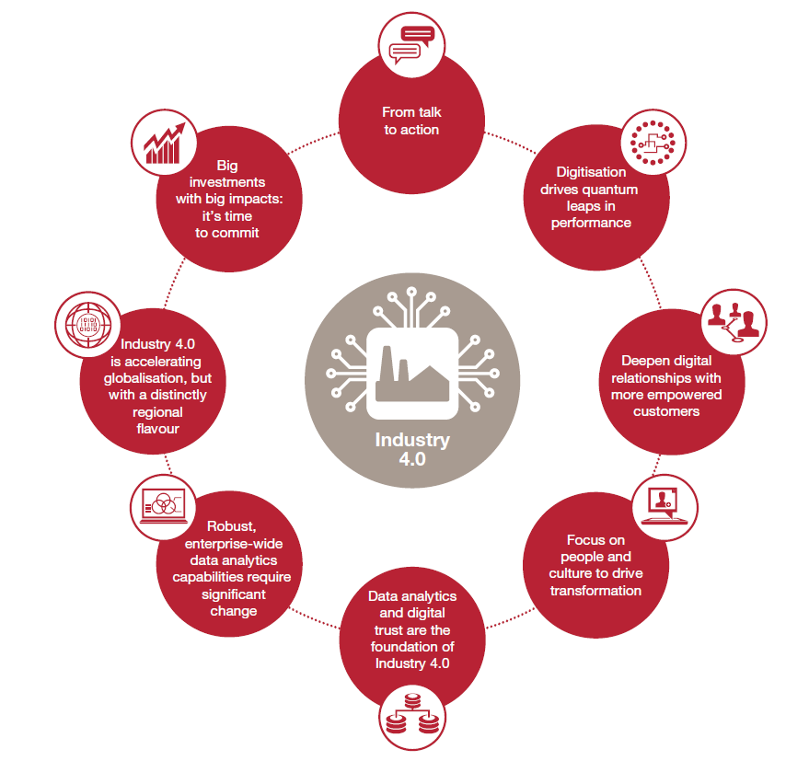
PwC’s 2016 Global Industry 4.0 Survey
Notes:
Izvor: PwC’s 2016 Global Industry 4.0 Survey of industrial companies

Slide 27
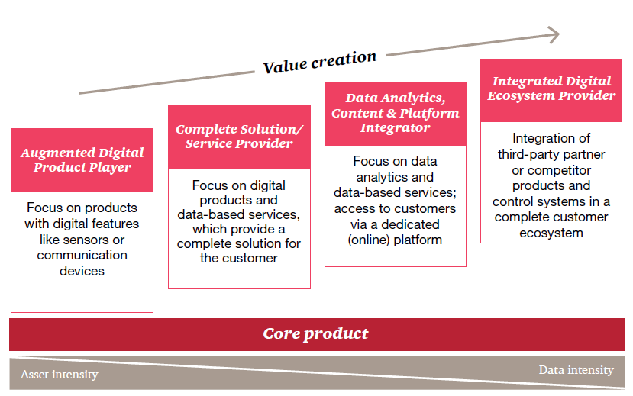
Industrial companies are moving towards greater digital value creation, from augmented products to serving digital ecosystems
Notes:
Izvor: PwC’s 2016 Global Industry 4.0 Survey of industrial companies

Slide 28
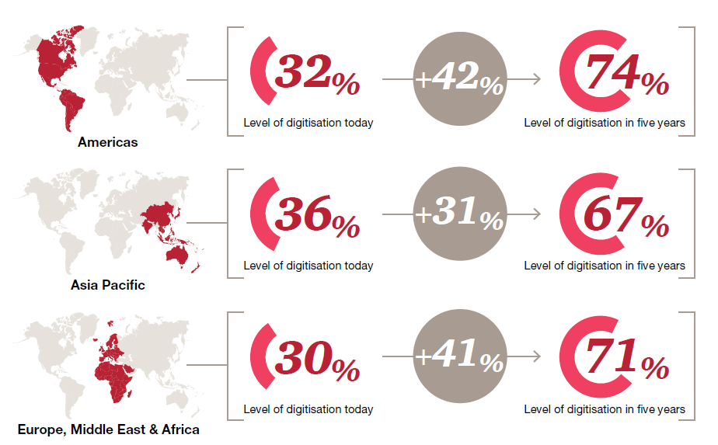
Digitisation increase over the next five years
Notes:
Izvor: PwC’s 2016 Global Industry 4.0 Survey of industrial companies

Slide 29
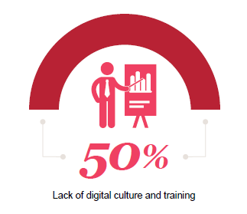
Lack of digital culture and training is the biggest challenge facing companies
Notes:
Izvor: PwC’s 2016 Global Industry 4.0 Survey of industrial companies

Slide 30

Što je za poslovima ?
Studija World Economic Foruma - The Future of Jobs, 2016.
Posljednja velika međunarodna studija na vrlo relevantnom uzorku (100 vodećih svjetskih kompanija sa 13 milijuna zposlenih)

Slide 31
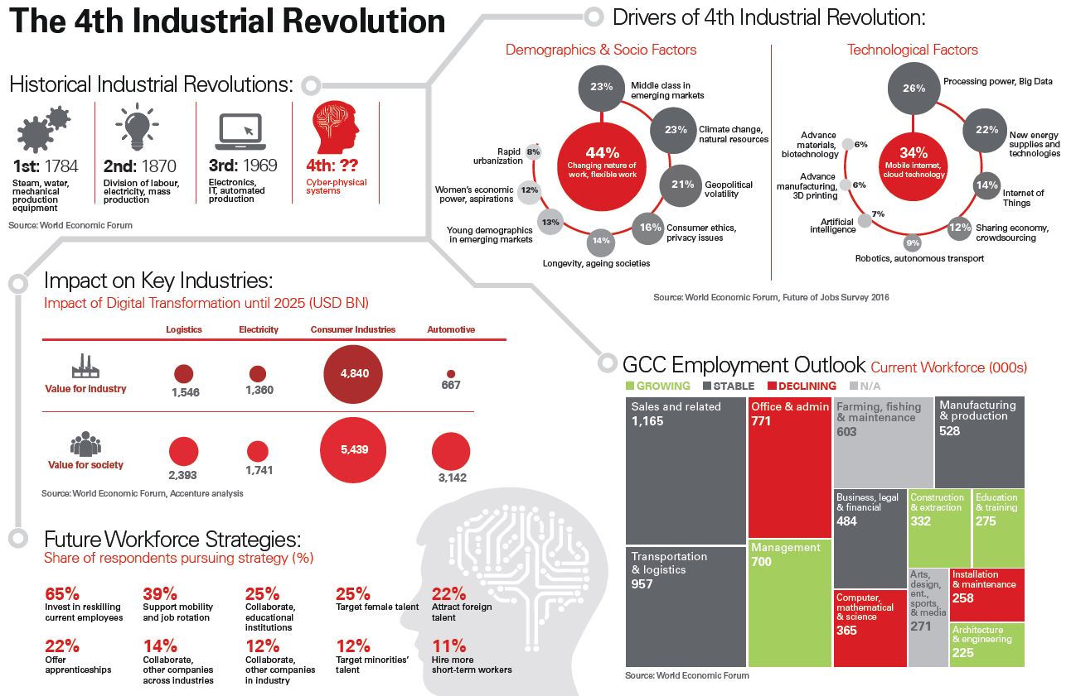

Slide 32
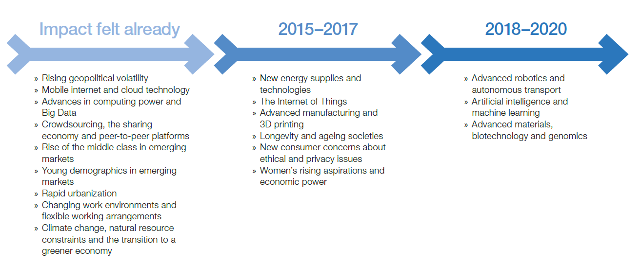
Tehnološki, demografski i socioekonomski trendovi koji utječu na modele poslovanja
Izvor: WEF, The Future of Jobs, 2016.

Slide 33
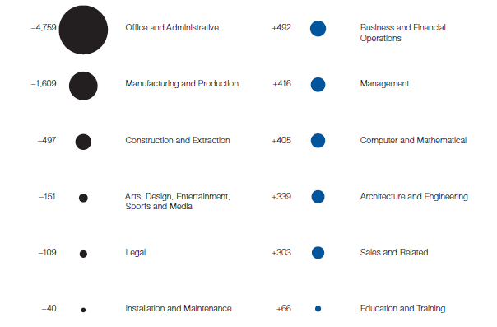
Neto izgledi za zapošljavanje prema odabranim grupama, 2015-2020
Izvor: WEF, The Future of Jobs, 2016.

Slide 34
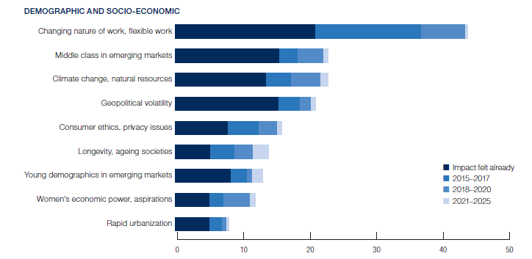
Pokretači promjena, vrijeme utjecaja na poslovne modele
Izvor: WEF, The Future of Jobs, 2016.

Slide 35
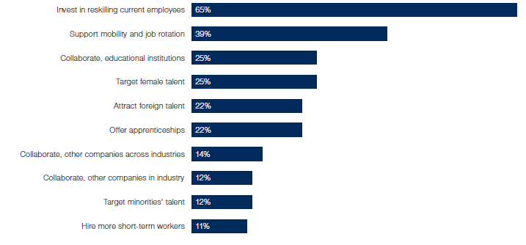
Strategije za popunjavanje radne snage
Izvor: WEF, The Future of Jobs, 2016.

Slide 36
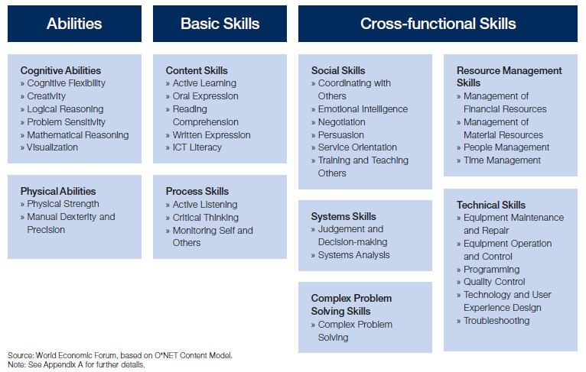
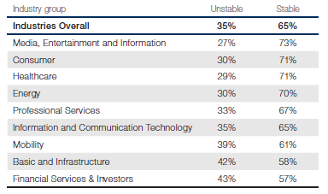
Utjecaj Industrije 4.0 na postojeće kompetencije zaposlenika
Promjene kompetencija, 2015-2020
Izvor: WEF, The Future of Jobs, 2016.

Slide 37
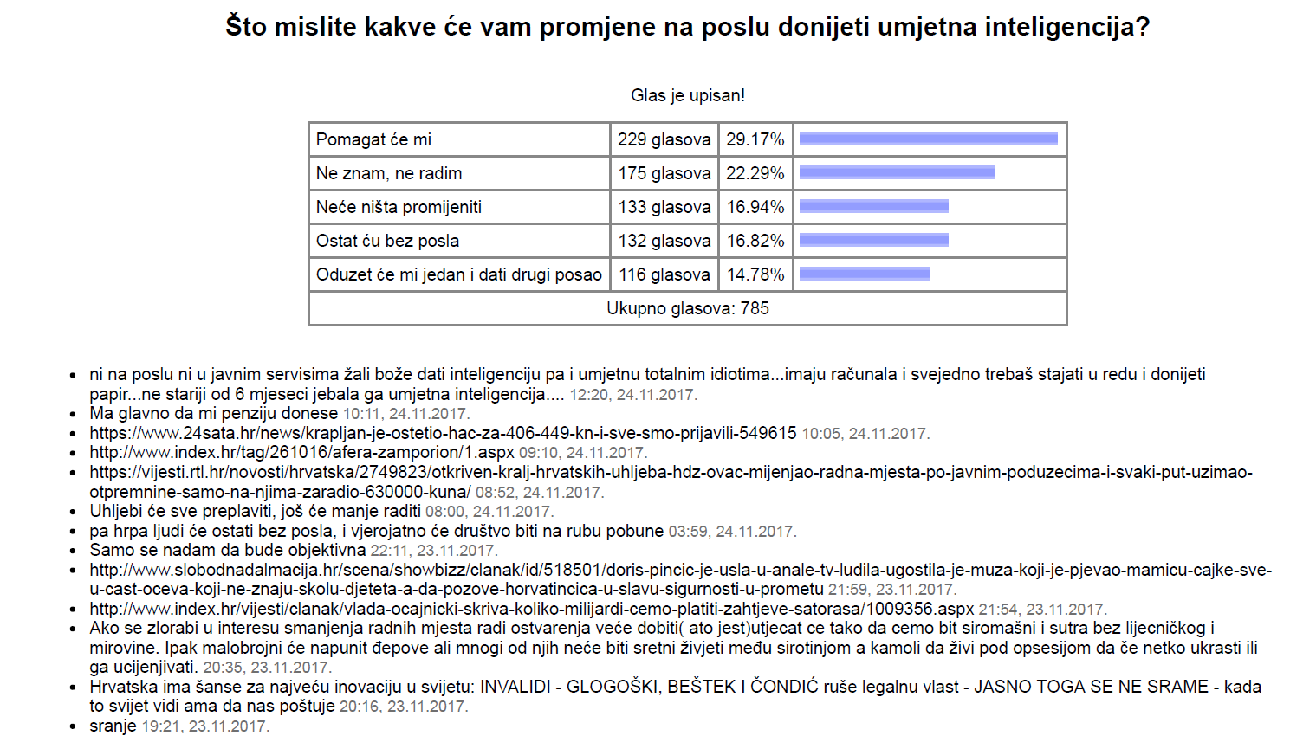

Slide 38
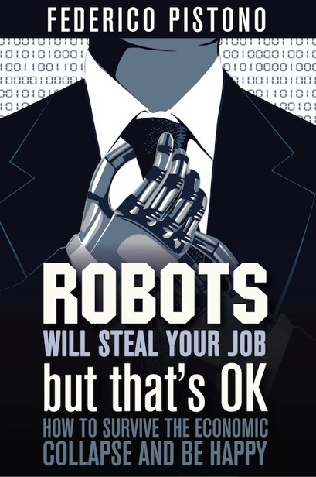
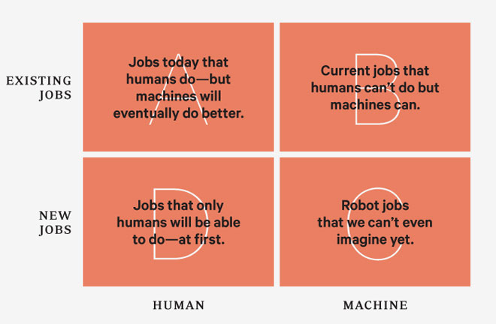
http://robotswillstealyourjob.com/read
Notes:
https://www.wired.com/2012/12/ff-robots-will-take-our-jobs/
The rows indicate whether robots will take over existing jobs or make new ones, and the columns indicate whether these jobs seem (at first) like jobs for humans or for machines.
Let’s begin with quadrant A: jobs humans can do but robots can do even better. Humans can weave cotton cloth with great effort, but automated looms make perfect cloth, by the mile, for a few cents. The only reason to buy handmade cloth today is because you want the imperfections humans introduce. We no longer value irregularities while traveling 70 miles per hour, though—so the fewer humans who touch our car as it is being made, the better.
And yet for more complicated chores, we still tend to believe computers and robots can’t be trusted. That’s why we’ve been slow to acknowledge how they’ve mastered some conceptual routines, in some cases even surpassing their mastery of physical routines. A computerized brain known as the autopilot can fly a 787 jet unaided, but irrationally we place human pilots in the cockpit to babysit the autopilot “just in case.” In the 1990s, computerized mortgage appraisals replaced human appraisers wholesale. Much tax preparation has gone to computers, as well as routine x-ray analysis and pretrial evidence-gathering—all once done by highly paid smart people. We’ve accepted utter reliability in robot manufacturing; soon we’ll accept it in robotic intelligence and service.
Next is quadrant B: jobs that humans can’t do but robots can. A trivial example: Humans have trouble making a single brass screw unassisted, but automation can produce a thousand exact ones per hour. Without automation, we could not make a single computer chip—a job that requires degrees of precision, control, and unwavering attention that our animal bodies don’t possess. Likewise no human, indeed no group of humans, no matter their education, can quickly search through all the web pages in the world to uncover the one page revealing the price of eggs in Katmandu yesterday. Every time you click on the search button you are employing a robot to do something we as a species are unable to do alone.
While the displacement of formerly human jobs gets all the headlines, the greatest benefits bestowed by robots and automation come from their occupation of jobs we are unable to do. We don’t have the attention span to inspect every square millimeter of every CAT scan looking for cancer cells. We don’t have the millisecond reflexes needed to inflate molten glass into the shape of a bottle. We don’t have an infallible memory to keep track of every pitch in Major League Baseball and calculate the probability of the next pitch in real time.
We aren’t giving “good jobs” to robots. Most of the time we are giving them jobs we could never do. Without them, these jobs would remain undone.
Now let’s consider quadrant C, the new jobs created by automation—including the jobs that we did not know we wanted done. This is the greatest genius of the robot takeover: With the assistance of robots and computerized intelligence, we already can do things we never imagined doing 150 years ago. We can remove a tumor in our gut through our navel, make a talking-picture video of our wedding, drive a cart on Mars, print a pattern on fabric that a friend mailed to us through the air. We are doing, and are sometimes paid for doing, a million new activities that would have dazzled and shocked the farmers of 1850. These new accomplishments are not merely chores that were difficult before. Rather they are dreams that are created chiefly by the capabilities of the machines that can do them. They are jobs the machines make up.
Before we invented automobiles, air-conditioning, flatscreen video displays, and animated cartoons, no one living in ancient Rome wished they could watch cartoons while riding to Athens in climate-controlled comfort. Two hundred years ago not a single citizen of Shanghai would have told you that they would buy a tiny slab that allowed them to talk to faraway friends before they would buy indoor plumbing. Crafty AIs embedded in first-person-shooter games have given millions of teenage boys the urge, the need, to become professional game designers—a dream that no boy in Victorian times ever had. In a very real way our inventions assign us our jobs. Each successful bit of automation generates new occupations—occupations we would not have fantasized about without the prompting of the automation.
To reiterate, the bulk of new tasks created by automation are tasks only other automation can handle. Now that we have search engines like Google, we set the servant upon a thousand new errands. Google, can you tell me where my phone is? Google, can you match the people suffering depression with the doctors selling pills? Google, can you predict when the next viral epidemic will erupt? Technology is indiscriminate this way, piling up possibilities and options for both humans and machines.
It is a safe bet that the highest-earning professions in the year 2050 will depend on automations and machines that have not been invented yet. That is, we can’t see these jobs from here, because we can’t yet see the machines and technologies that will make them possible. Robots create jobs that we did not even know we wanted done.
Finally, that leaves us with quadrant D, the jobs that only humans can do—at first. The one thing humans can do that robots can’t (at least for a long while) is to decide what it is that humans want to do. This is not a trivial trick; our desires are inspired by our previous inventions, making this a circular question.
When robots and automation do our most basic work, making it relatively easy for us to be fed, clothed, and sheltered, then we are free to ask, “What are humans for?” Industrialization did more than just extend the average human lifespan. It led a greater percentage of the population to decide that humans were meant to be ballerinas, full-time musicians, mathematicians, athletes, fashion designers, yoga masters, fan-fiction authors, and folks with one-of-a kind titles on their business cards. With the help of our machines, we could take up these roles; but of course, over time, the machines will do these as well. We’ll then be empowered to dream up yet more answers to the question “What should we do?” It will be many generations before a robot can answer that.
This postindustrial economy will keep expanding, even though most of the work is done by bots, because part of your task tomorrow will be to find, make, and complete new things to do, new things that will later become repetitive jobs for the robots. In the coming years robot-driven cars and trucks will become ubiquitous; this automation will spawn the new human occupation of trip optimizer, a person who tweaks the traffic system for optimal energy and time usage. Routine robo-surgery will necessitate the new skills of keeping machines sterile. When automatic self-tracking of all your activities becomes the normal thing to do, a new breed of professional analysts will arise to help you make sense of the data. And of course we will need a whole army of robot nannies, dedicated to keeping your personal bots up and running. Each of these new vocations will in turn be taken over by robots later.
The real revolution erupts when everyone has personal workbots, the descendants of Baxter, at their beck and call. Imagine you run a small organic farm. Your fleet of worker bots do all the weeding, pest control, and harvesting of produce, as directed by an overseer bot, embodied by a mesh of probes in the soil. One day your task might be to research which variety of heirloom tomato to plant; the next day it might be to update your custom labels. The bots perform everything else that can be measured.
Right now it seems unthinkable: We can’t imagine a bot that can assemble a stack of ingredients into a gift or manufacture spare parts for our lawn mower or fabricate materials for our new kitchen. We can’t imagine our nephews and nieces running a dozen workbots in their garage, churning out inverters for their friend’s electric-vehicle startup. We can’t imagine our children becoming appliance designers, making custom batches of liquid-nitrogen dessert machines to sell to the millionaires in China. But that’s what personal robot automation will enable.
Everyone will have access to a personal robot, but simply owning one will not guarantee success. Rather, success will go to those who innovate in the organization, optimization, and customization of the process of getting work done with bots and machines. Geographical clusters of production will matter, not for any differential in labor costs but because of the differential in human expertise. It’s human-robot symbiosis. Our human assignment will be to keep making jobs for robots—and that is a task that will never be finished. So we will always have at least that one “job.”

Slide 39

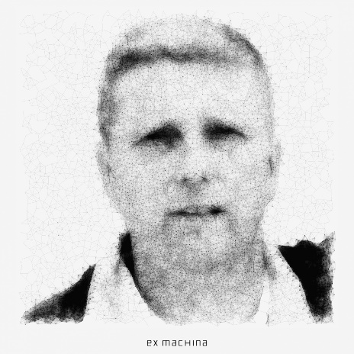
DAMIR MEDVED
damir.medved@ericsson.com
Ericsson NT Principal Consultant
  SmartCity Standards Development
  SmartCity Product Development
  Broadband Infrastructure Development
  New Area Sales Manager
  Coach and Mentor
NGO Activist
  President of Heritage Society „Without Borders” Drenova, Rijeka
  Technology
  Culture
  Ecology

